Slide 1
OpenPlaza
Digital Market Database

Slide 2
Finished Project

Slide 3
Backend Updates
Security improvements
Hardened against SQL injection
Upgraded to be Mockaroo complaint in the ‘users’ table

Slide 4
Frontend Updates
Entirely new, sleeker frontend template from Start Bootstrap
Pictures for individual products along with their listings
Better interfaces

Slide 5
Challenges
Inexperience with building websites.
Putting in the necessary time.
Balance of work between teammates.

Slide 6
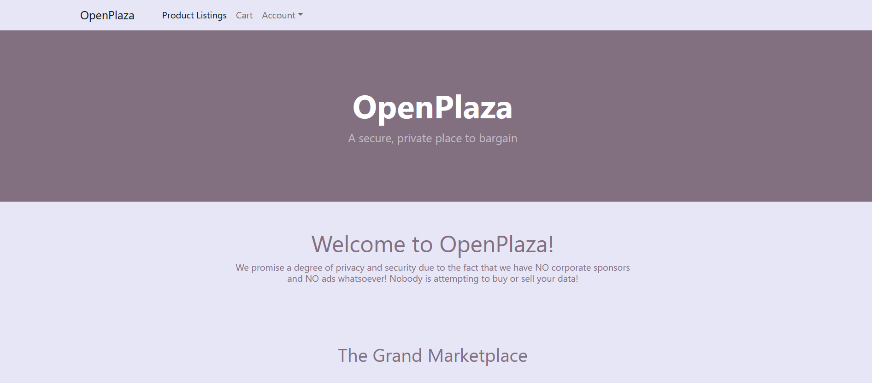
Front Page

Slide 7
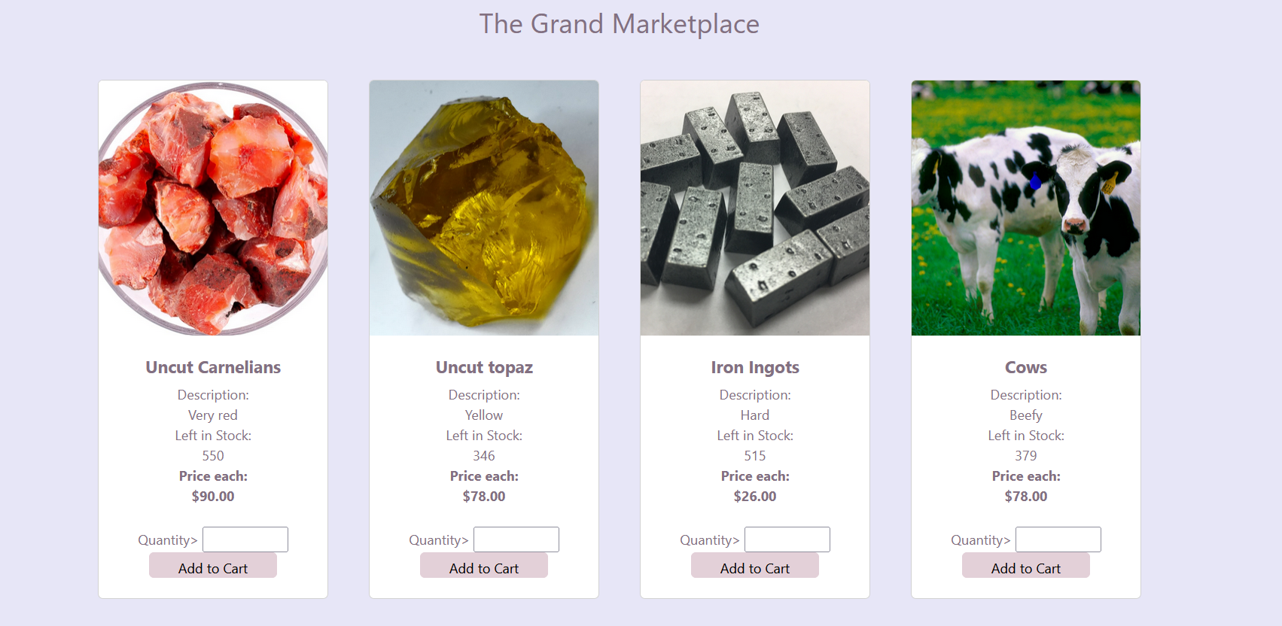
Front Page – Scrolled Down

Slide 8
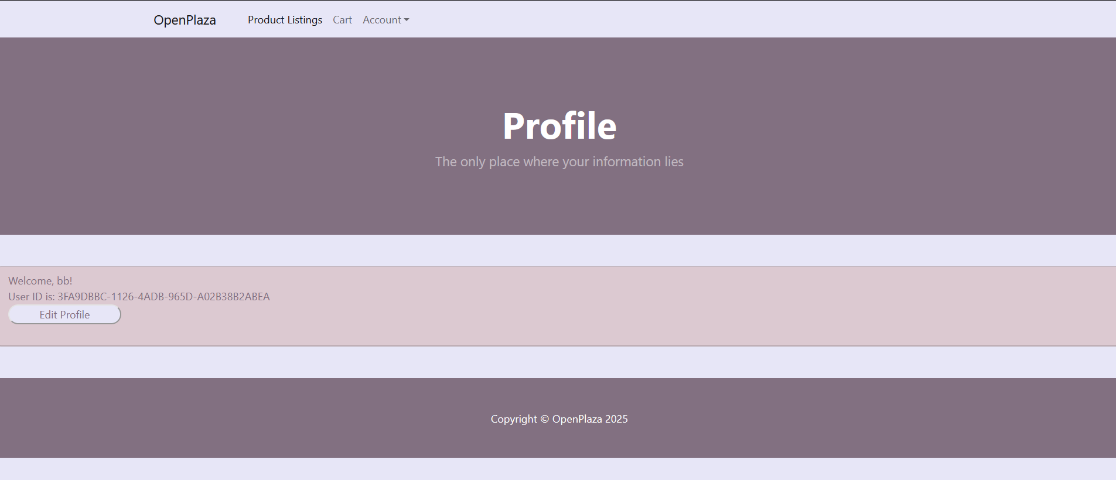
User Profile

Slide 9
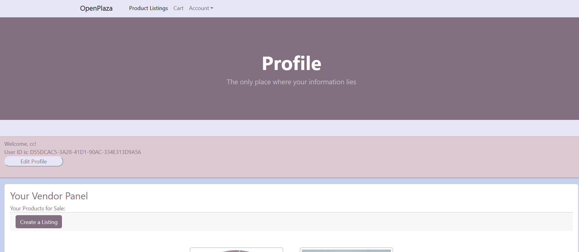
Vendor Profile

Slide 10
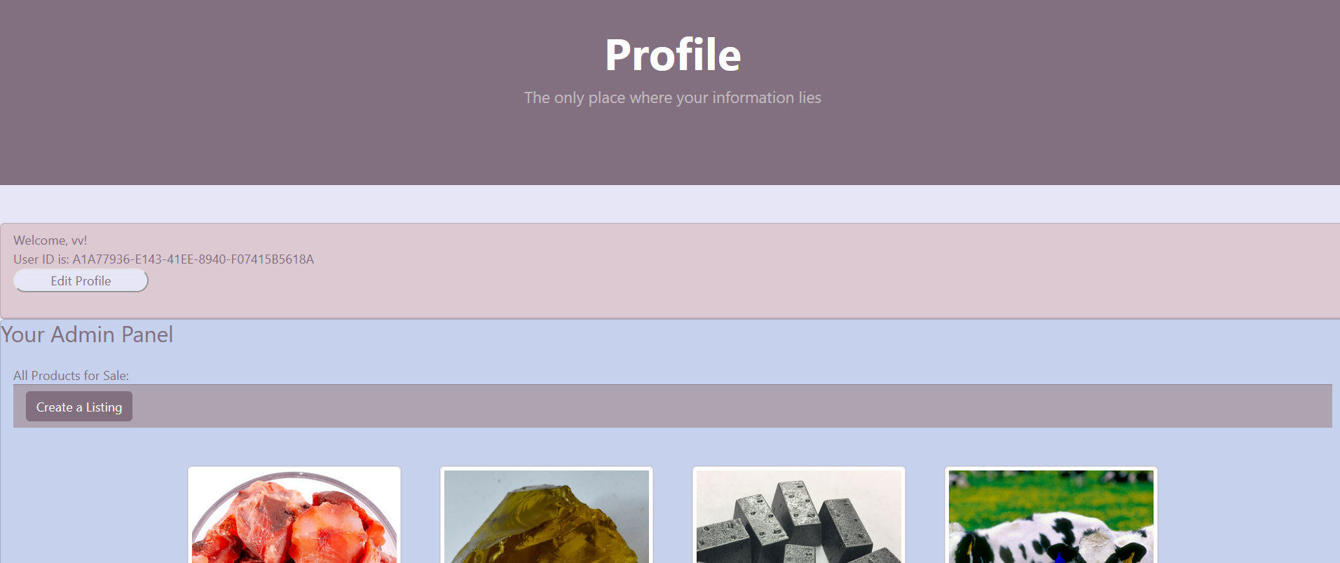
Admin Profile - products table

Slide 11
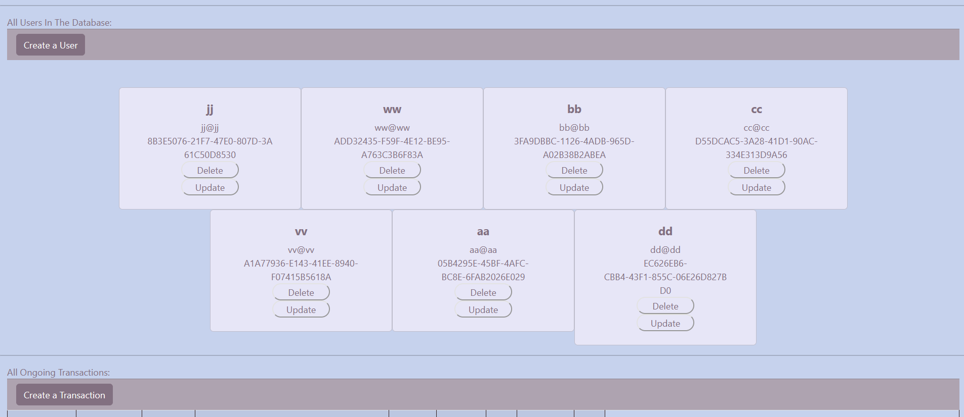
Admin profile – users table

Slide 12
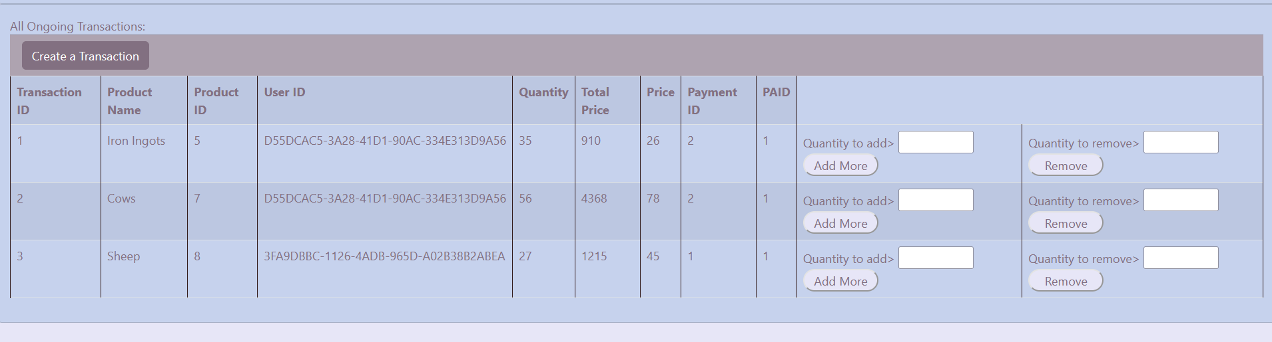
Admin profile – transactions table

Slide 13
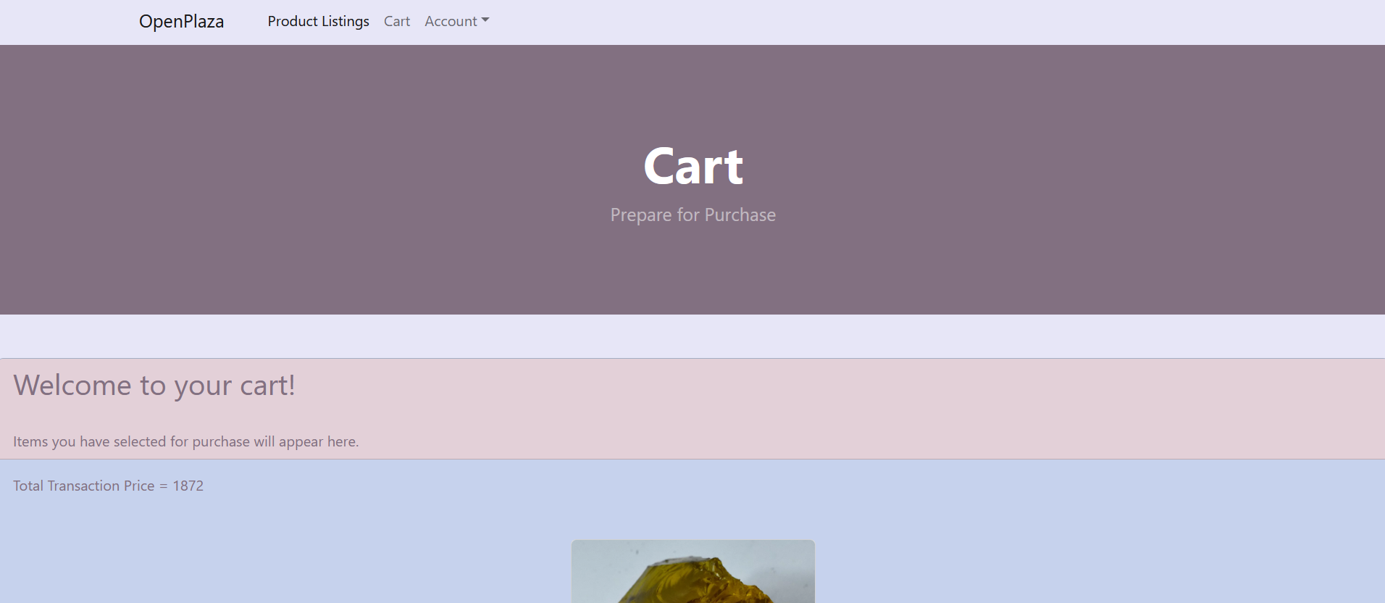

Cart

Slide 14
Challenges
Inexperience with building websites.
Putting in the necessary time.
Balance of work between teammates.

Slide 15
Demonstration
Please wait for screen transition

Slide 16
Thank you
Todd Carter, V01187982
cart7982@vandals.uidaho.edu
Anna Milligan, V00815672
bookwormer104@gmail.com

